Slide 1
Day 15
Kinematics of Wheeled Robots

Slide 2
Wheeled Mobile Robots
robot can have one or more wheels that can provide
steering (directional control)
power (exert a force against the ground)
an ideal wheel is
perfectly round (perimeter 2πr)
moves in the direction perpendicular to its axis

Slide 3
Wheel

Slide 4
Deviations from Ideal

Slide 5
Instantaneous Center of Curvature
for smooth rolling motion, all wheels in ground contact must
follow a circular path about a common axis of revolution
each wheel must be pointing in its correct direction
revolve with an angular velocity consistent with the motion of the robot
each wheel must revolve at its correct speed

Slide 6
Instantaneous Center of Curvature

Slide 7
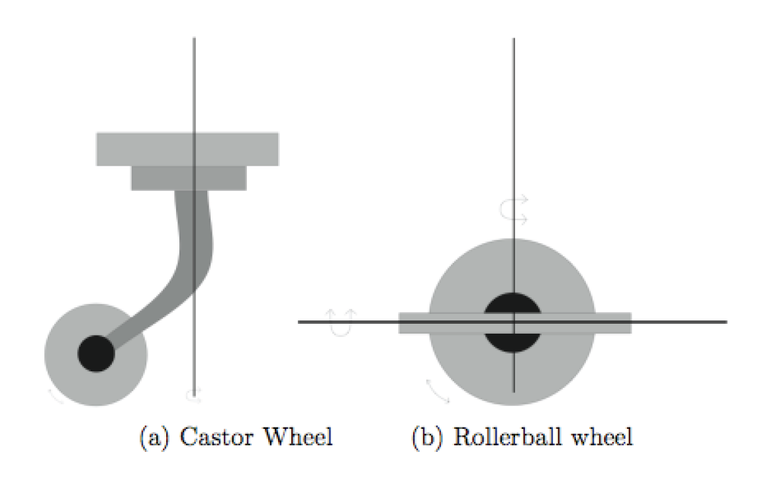
Castor Wheels
provide support but not steering nor propulsion

Slide 8
Tangent Bug
O₂
O₃
O₁
O₆
O₄
O₅

Slide 9
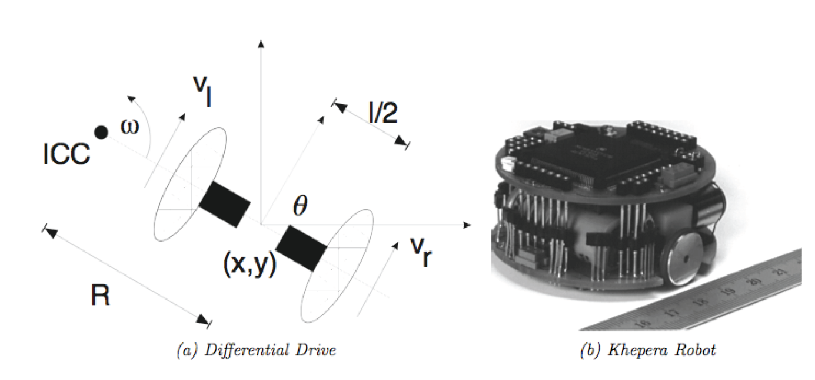
Differential Drive
two independently driven wheels mounted on a common axis

Slide 10
Differential Drive
velocity constraint defines the wheel ground velocities
given the wheel ground velocities

Slide 11
Forward Kinematics
for a robot starting with pose [0 0 0]^{T} moving with velocity V(t) in a direction θ(t) :

Slide 12
Forward Kinematics
for differential drive:

Slide 13
Sensitivity to Wheel Velocity
σ = 0.05
σ = 0.01

